Slide 1

Remote Learning C#

Slide 2

Introduction
As per your votes, we will continue to meet Fridays at 12:00.
I’ve sent the invites up to the 23rd of April.
It’s up to us whether we skip the week with the 30th of April completely (module 2 will end on the 21st of May). We will have another vote about this on slack soon.
We decided on the game night for: 19.03.2021 – 18:00.

Slide 3
Lambda Expressions Extension Methods LINQ Reflection

Slide 4
Recap: delegates
A delegate is a type that represents references to methods with a particular parameter list and return type.
public delegate void HandleMessage(string message);
public static void WriteMessageToConsole(string message)
{
Console.WriteLine(message);
}
// Instantiate the delegate.
HandleMessage handler = WriteMessageToConsole;
// Call the delegate.
handler("Hello World") // Will print “Hello World” to the Console

Slide 5
Recap: delegates
In computer programming, a callback is executable code that is passed as an argument to other code.
public delegate void HandleMessage(string message);
public static void WriteMessageToConsole(string message)
{
Console.WriteLine(message);
}
public static void MethodWithCallback(int param1, int param2, HandleMessage callback)
{
callback("The sum is: " + (param1 + param2).ToString());
}
// Instantiate the delegate.
HandleMessage handler = WriteMessageToConsole;
// Call the MethodWithCallBack method, giving it the delegate.
MethodWithCallback(1, 2, handler); // Will print “The sum is 3” to the Console.

Slide 6
Anonymous functions – since C# 2.0
public delegate void HandleMessage(string message);
public static void MethodWithCallback(int param1, int param2, HandleMessage callback)
{
callback("The sum is: " + (param1 + param2).ToString());
}
The anonymous delegate is defined in the Main method, not as a separate method.
// Define the delegate
HandleMessage handler = delegate (string message)
{
Console.WriteLine(message);
};
// Call the MethodWithCallBack method, giving it the delegate.
MethodWithCallback(1, 2, handler); // Will print “The sum is 3” to the Console.

Slide 7
Lambda expressions – since C# 3.0
public delegate void HandleMessage(string message);
public static void MethodWithCallback(int param1, int param2, HandleMessage callback)
{
callback("The sum is: " + (param1 + param2).ToString());
}
// Call the MethodWithCallBack method, giving a lambda expression.
MethodWithCallback(1, 2, message => Console.WriteLine(message));
// Will print “The sum is 3” to the Console.
The parameter type is optional in this case, because it is inferred.
The lambda expression is defined in the Main method.

Slide 8
Lambda expressions
HandleMessage handler = delegate (string message)
{
Console.WriteLine(message);
};
MethodWithCallback(1, 2, handler);
MethodWithCallback(1, 2, message => Console.WriteLine(message));

Slide 9
Lambda expressions
HandleMessage handler = delegate (string message)
{
Console.WriteLine(message);
};
MethodWithCallback(1, 2, handler);
+ ”=>”
MethodWithCallback(1, 2, message => Console.WriteLine(message));

Slide 10
Lambda expressions - Syntax
message => Console.WriteLine(message)
input-parameter => expression
(message,secondMessage) => Console.WriteLine(message + “ and “ + secondMessage)
(input-parameters) => expression
(message,secondMessage) =>
{
Console.WriteLine(message);
Console.WriteLine(“Also: “ + secondMessage);
}
(input-parameters) =>
{
sequence of statements
}

Slide 11
Extension Methods
Extension methods enable you to "add" methods to existing types without creating a new derived type, recompiling, or otherwise modifying the original type. Extension methods are static methods, but they're called as if they were instance methods on the extended type

Slide 12
Extension Methods
Extension methods enable you to "add" methods to existing types without creating a new derived type, recompiling, or otherwise modifying the original type. Extension methods are static methods, but they're called as if they were instance methods on the extended type
So, extension methods are useful when:
- we don’t want to change/extend a type
- the type we want to add a functionality to is sealed
- the type we want to add a functionality to is a struct(sealed by default)

Slide 13
Extension Methods
MyTypeExtensions
ExtensionMethod(…)
MyType
Method()
Main
var myObj = new MyType();
myObj.ExtensionMethod();

Slide 14
Extension Methods
public static class MyTypeExtensions
{
public static void ExtensionMethod(this MyType myTypeObject)
{
// extension method code
}
}
MyType
Method()
binding parameter
Main
var myObj = new MyType();
myObj.ExtensionMethod();

Slide 15
Extension Methods
public class DomainEntity
{
public int Id { get; set; }
public string FirstName { get; set; }
public string LastName { get; set; }
}
Extension methods can be used to add functionality that is specific to each application layer without loading the object down with methods not needed or wanted in other layers.
static class DomainEntityExtensions
{
static string FullName(this DomainEntity value)
=> $"{value.FirstName} {value.LastName}";
}
var domainEntity = new DomainEntity{…};
var fullName = domainEntity.FullName;

Slide 16
Linq – Ienumerable, Iqueryable
The System.Linq namespace provides classes and interfaces that support queries that use Language-Integrated Query (LINQ).

Slide 17
Linq
public static void Main()
{
var list = new List<Person>{
new Person{FirstName = "Ion", LastName = "Pop", Location = "Bucharest"},
new Person{FirstName = "Andreea", LastName = "Rusu", Location = "Iasi"},
new Person{FirstName = "Georgia", LastName = "Blaga", Location = "Cluj"},
new Person{FirstName = "Dragos", LastName = "Aanei", Location = "Cluj" }};
var peopleWhoLiveInCluj = list
.Where(person => person.Location.Equals("Cluj"))
.ToList();
}

Slide 18
Linq
public static void Main()
{
var list = new List<Person>{
new Person{FirstName = "Ion", LastName = "Pop", Location = "Bucharest"},
new Person{FirstName = "Andreea", LastName = "Rusu", Location = "Iasi"},
new Person{FirstName = "Georgia", LastName = "Blaga", Location = "Cluj"},
new Person{FirstName = "Dragos", LastName = "Aanei", Location = "Cluj" }};
var lastNamesFromCluj = list
.Where(person => person.Location.Equals("Cluj"))
.Select(person => person.LastName)
.ToList();
}

Slide 19
Linq
public static void Main()
{
var list = new List<Person>{
new Person{FirstName = "Ion", LastName = "Pop", Location = "Bucharest"},
new Person{FirstName = "Andreea", LastName = "Rusu", Location = "Iasi"},
new Person{FirstName = "Georgia", LastName = "Blaga", Location = "Cluj"},
new Person{FirstName = "Dragos", LastName = "Aanei", Location = "Cluj" }};
var lastNamesFromCluj = list
.Where(person => person.Location.Equals("Cluj"))
.Select(person => person.LastName)
.ToList();
}
Extension methods!
Lambda expressions!

Slide 20
Linq – Ienumerable
var lastNamesFromCluj = list
.Where(person => person.Location.Equals("Cluj"))
.Select(person => person.LastName)
.ToList();
public static System.Collections.Generic.IEnumerable<TSource> Where<TSource>
(this System.Collections.Generic.IEnumerable<TSource> source,
Func<TSource,bool> predicate)
binding parameter
predicate

Slide 21
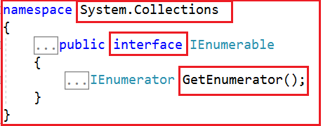
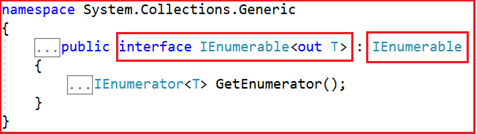
Linq – Ienumerable
As we see from the above image, IEnumerable is an interface that is available in System.Collections namespace.
List<T> implements the IEnumerable<T>, and IEenumerable interfaces. Therefore we were able to call the Enumerable.Where method in the earlier example.

Slide 22
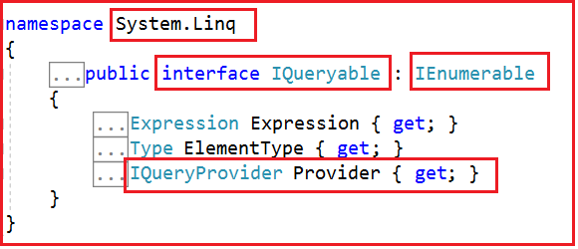
Linq – IQueryable
IQueryable is an interface and it is available in System.Linq namespace. The IQuerable interface is a child of the IEnumerable interface. So we can store IQuerable in a variable of type IEnumerable.

Slide 23
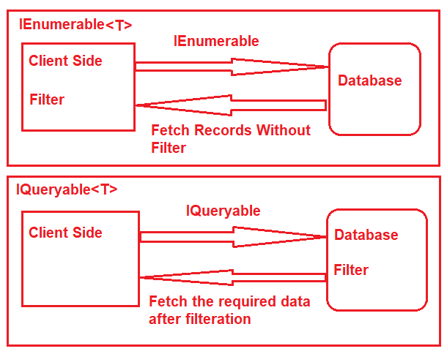
Linq – Ienumerable vs IQueryAble

Slide 24
Linq – Ienumerable vs IQueryAble
SELECT
[Extent1].[ID] AS [ID],
[Extent1].[FirstName] AS [FirstName],
[Extent1].[LastName] AS [LastName],
[Extent1].[Gender] AS [Gender]
FROM [dbo].[Student] AS [Extent1]
WHERE 'Male' = [Extent1].[Gender]
IEnumerable<Student> listStudents =
dBContext.Students
.Where(x => x.Gender == "Male");
listStudents = listStudents.Take(2);
vs
SELECT TOP (2)
[Extent1].[ID] AS [ID],
[Extent1].[FirstName] AS [FirstName],
[Extent1].[LastName] AS [LastName],
[Extent1].[Gender] AS [Gender]
FROM [dbo].[Student] AS [Extent1]
WHERE 'Male' = [Extent1].[Gender]
IQueryable<Student> listStudents =
dBContext.Students
.AsQueryable()
.Where(x => x.Gender == "Male");
listStudents = listStudents.Take(2);

Slide 25
Linq – Ienumerable vs IQueryAble
while querying the data from the database, the IEnumerable executes the “select statement” on the server-side (i.e. on the database), loads data into memory on the client-side and only then applies the filters on the retrieved data.
use the IEnumerable when you need to query data from in-memory collections like List, Array and so on.
vs
while querying the data from a database, the IQueryable executes the “select query” with the applied filters on the server-side i.e. on the database and then retrieves the data.
use the IQueryable when you want to query the data from out-memory such as remote database, service, etc.

Slide 26
Linq – Ienumerable vs IQueryAble
*For more differences, see https://dotnettutorials.net/lesson/differences-between-ienumerable-and-iqueryable/

Slide 27
Deferred execution – bonus yield example
Deferred execution = the evaluation of an expression is delayed until its output value is actually required.
Deferred execution in C# can be obtain through "yield".
Demo: see comment

Slide 28
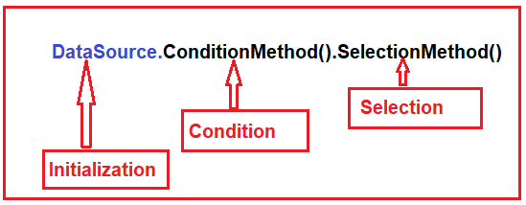
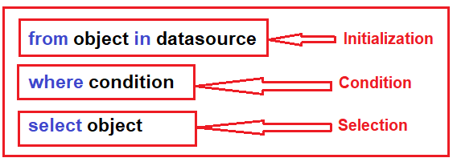
Linq – Method/query syntax
Method syntax:
list.Where(person => person.Location.Equals("Cluj")).Select(person => person.LastName)
Query sytax:
from person in list where person.Location.Equals("Cluj") select person.LastName

Slide 29
Linq – Method/query syntax
From the performance point of view there is no difference between the two approaches.
So, which method you chose to use, it totally depends on your personal preference, behind the scenes, the LINQ queries written using query syntax are translated into their lambda expressions before they are compiled.
Your preferences might depend on some syntactic sugar differences between the two, e.g. the “let” keyword:
var methodSyntax = people
.Select(person => new {
YearsWorking = GetYearsWorking(person),
Name = person.Name })
.Where(x => x.YearsWorking > 4)
.OrderBy(x => x.YearsWorking)
.Select(x => x.Name);
var querySyntax =
from person in people
let yearsWorking = GetYearsWorking(person)
where yearsWorking > 4
orderby yearsWorking
select person.Name;

Slide 30
REFLECTIOn
A way of interrogating, at runtime, the contents of an assembly (types, methods, properties, fields, etc...)
E.g.

